Slide 2
Arab Bank
Security Training
Amman, Jordan
Kerala, India
https://www.arabbank.com/

Slide 3
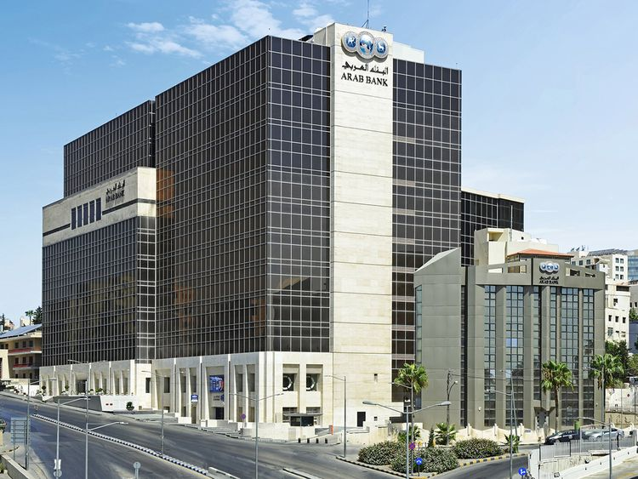

Slide 4
About Jordan
Climate : Moderate
Languages: Arabic, English
Seasons: Spring, Autumn, Winter, Summer.
Independence Day : 25/May/1946
Time: -2:30 Hours.
Population: Jordan11,337,052 Vs Kerala 33,406,061 Vs India1,210,576,856
Area: 1,680 km²
Area code: +962(79)
Capital : Amman

Slide 5
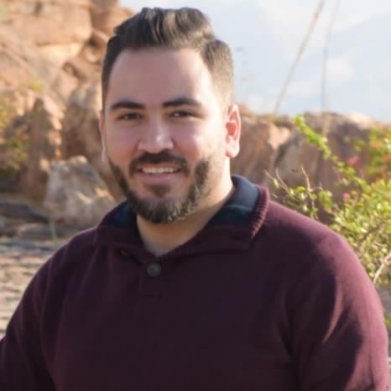
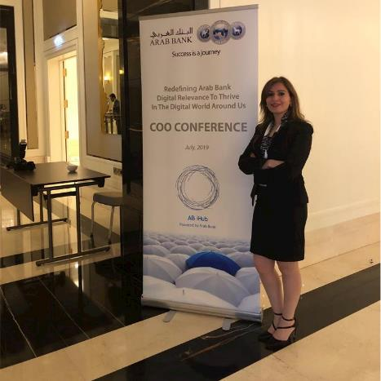
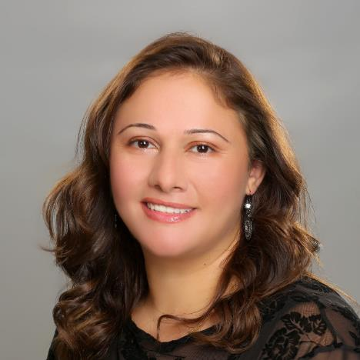
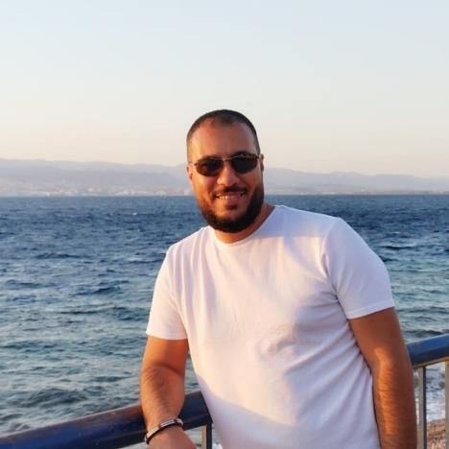
Meet the Team
How can we help you
Sewar Alzoubi
Rula Al-asa'd
Layla Al Zoubi
Mohammad Al Barghouthi
Deputy CISO
Head of cybersecurity Operation Control and cloud management
Head of Security Architecture, Security Program and Security
Information Security Assurance and Compliance Manager

Slide 6
One Team One vision

Slide 7
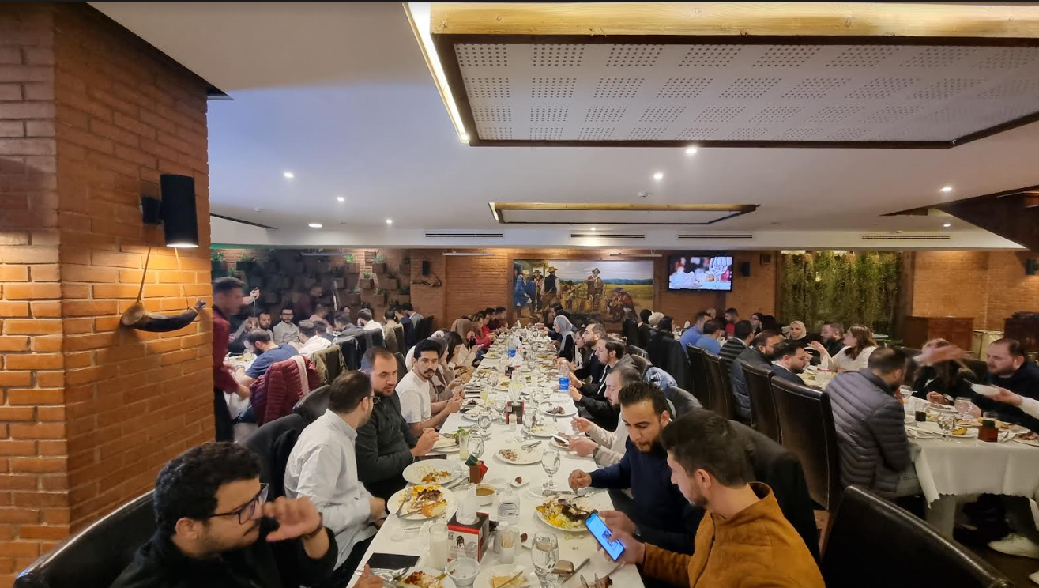
Meet the Team

Slide 8
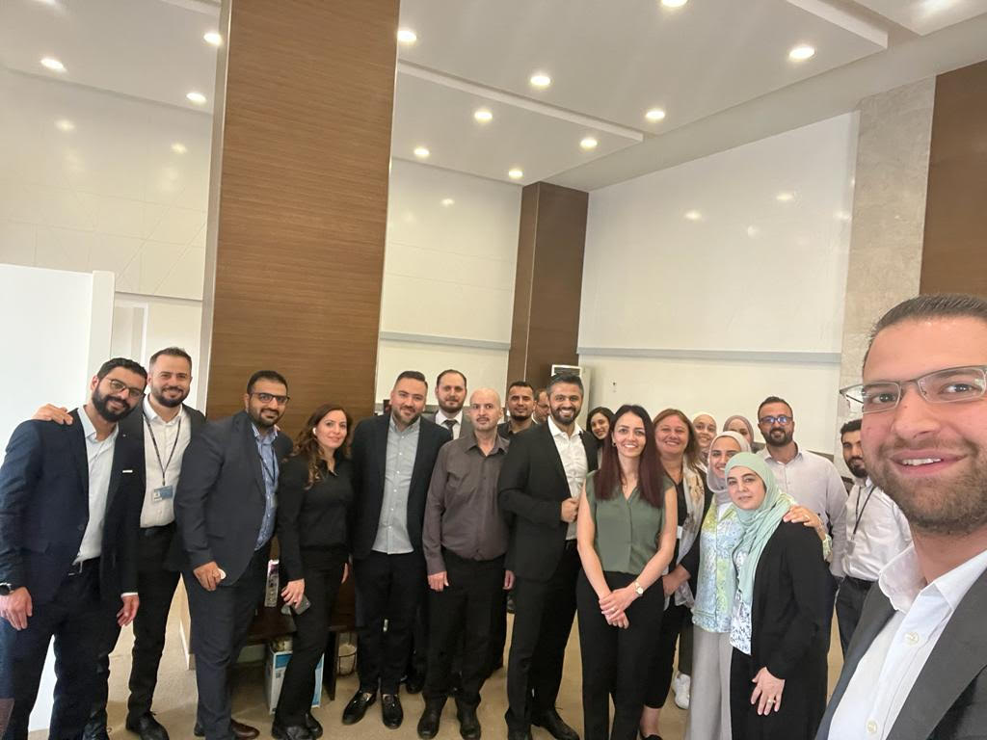
Meet the Team

Slide 9
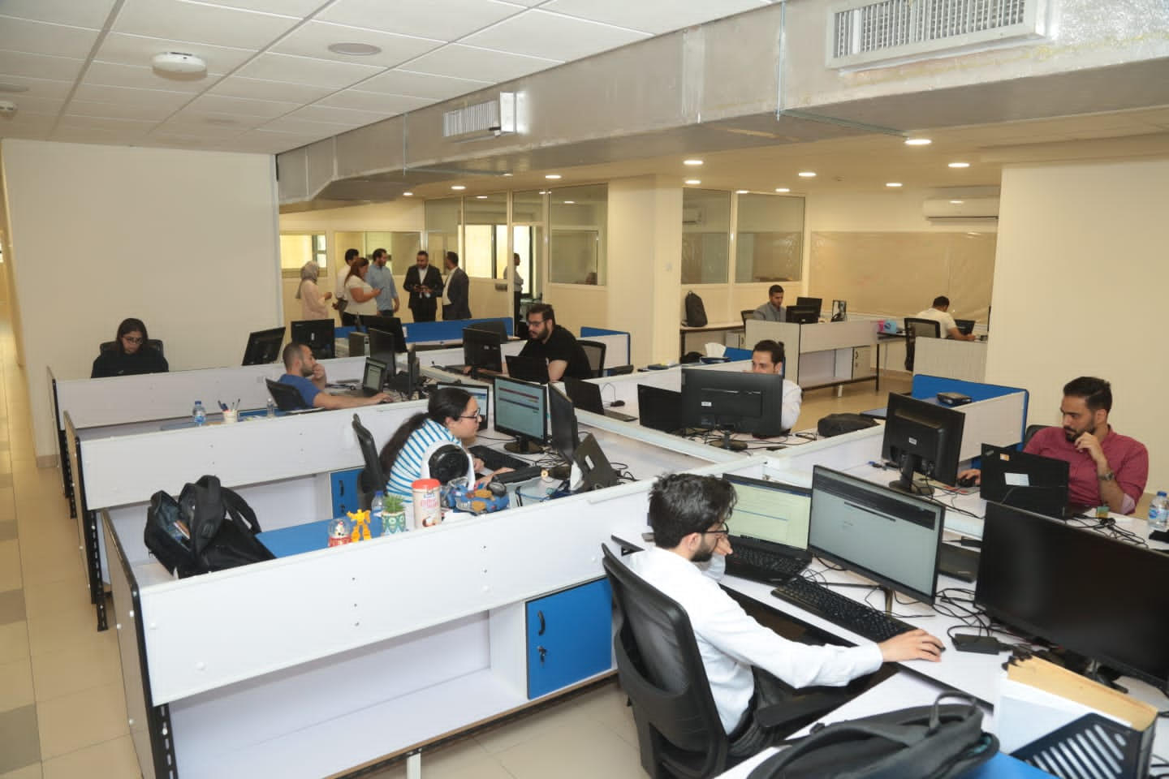
Meet the Team

Slide 10
Before we Start
Act honorably, honestly, justly, responsibly, and legally.
“Lead by example”
1
Don’t Use The Organization’s Assets Illegally
2
Don’t provide Organization information to Unauthorized Parties
3
Don’t forward business related emails to personal email
4
Don’t share passwords
5
Don’t leave hard copy's in an unprotected areas

Slide 11
Why Security?
Security is important because it helps to ensure
that an organization is able to continue to exist
and operate in spite of any attempts to steal
its data or compromise its physical or logical elements.

Slide 12
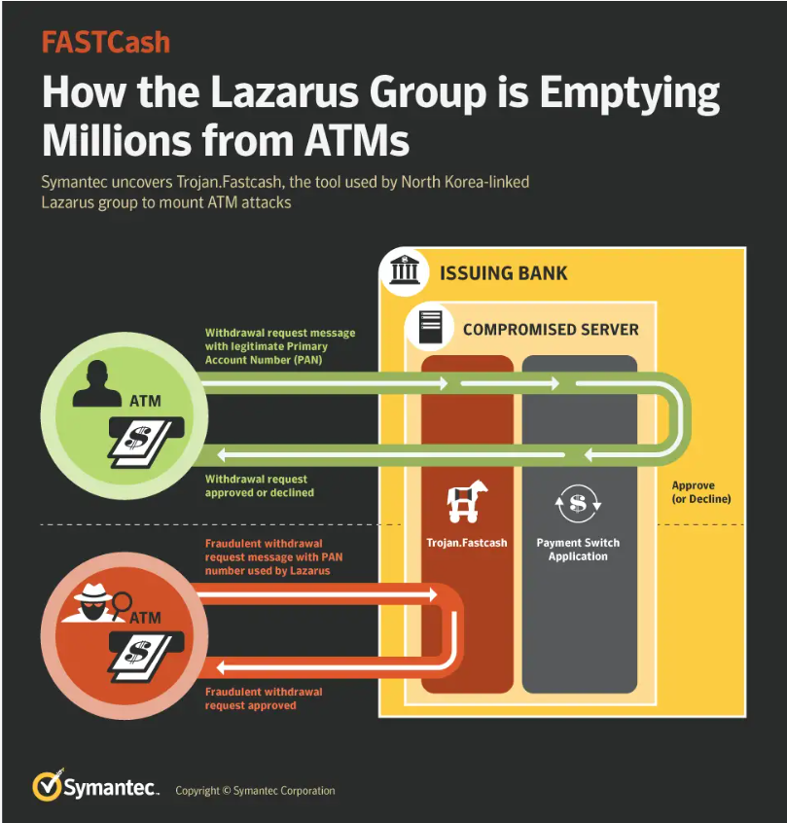
Attack 1
FastCash
On October 2, 2018, an alert was issued by US-CERT, the Department of Homeland Security, the Department of the Treasury, and the FBI. According to this new alert, Hidden Cobra (the U.S. government’s code name for Lazarus) has been conducting “FASTCash” attacks, stealing money from Automated Teller Machines (ATMs) from banks in Asia and Africa since at least 2016.

Slide 13
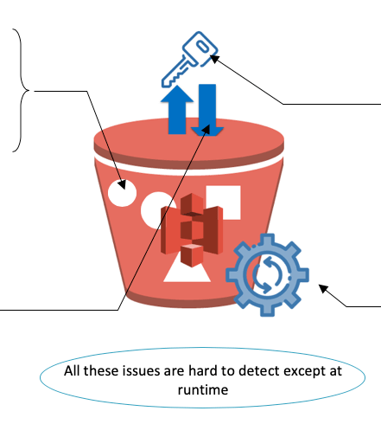
Attack 2
Key Ring Exposed Bucket
Insecure cloud, container or orchestration configuration

Slide 14
Security is everyone's responsibility

Slide 15
Organization (Security)
Security exists to support the objectives, mission, and goals of the organization.
Business
We wouldn't be here if there wasn't any products or services.
B
Risk
Decide the risk appetite: the amount of risk an organization is willing to take in
R
Security professional
S
Designing and implementing security solutions based on the approved security policy
I
Information technology
Install, Implement, support, maintaining, repair computer systems (hardware, software)

Slide 16
Takeaway
Security is a business enabler.
Security gives the risk team a greater assurance that their risk is
secure and that they can deal with a wider variety of risks to push the
business forward. If we don't have this insight, we will continue to
function at the same level.

Slide 17
Concepts
Malwares
Security is everyone's responsibility
4
1
2
3
Network Types
Network Security
Endpoint Security
Malwares
5
6
7
8
Hardening
Cyber kill chain
Defense in depth
CIA Triad
9
10
11
12
Data Lifecycle
Threat Modeling
False Positive
Social engineering
13
14
15
16
Change Management
Zero Trust
Physical Security
Common Attacks
17
18
19
20
Cryptography
Threat Hunting
VPN
False Positive
PC DSS
Incident response

Slide 18
Concepts
Security is everyone's responsibility
1
Cryptography
Network Types

Slide 19
Networks
Data Is The New Perimeter
LAN
Local Area Network
VLAN
Virtual local area network
WLAN
Wireless
WAN
Wide Area Network
Micro Segmentation
SDN
Software Defined Network

Slide 20
Concepts
Security is everyone's responsibility
2
Cryptography
Network Security

Slide 21
Network Security
Protect your front door
Firewalls.
IPS.
IDS.
Intrusion Prevention System
Intrusion Detection System
Proxy.
NDR.
WAF.
Network Detection and Response
Web Application Firewall
VPN.
Deception.
Honeynet.
Virtual Private Network
Threats and Advanced attack

Slide 22
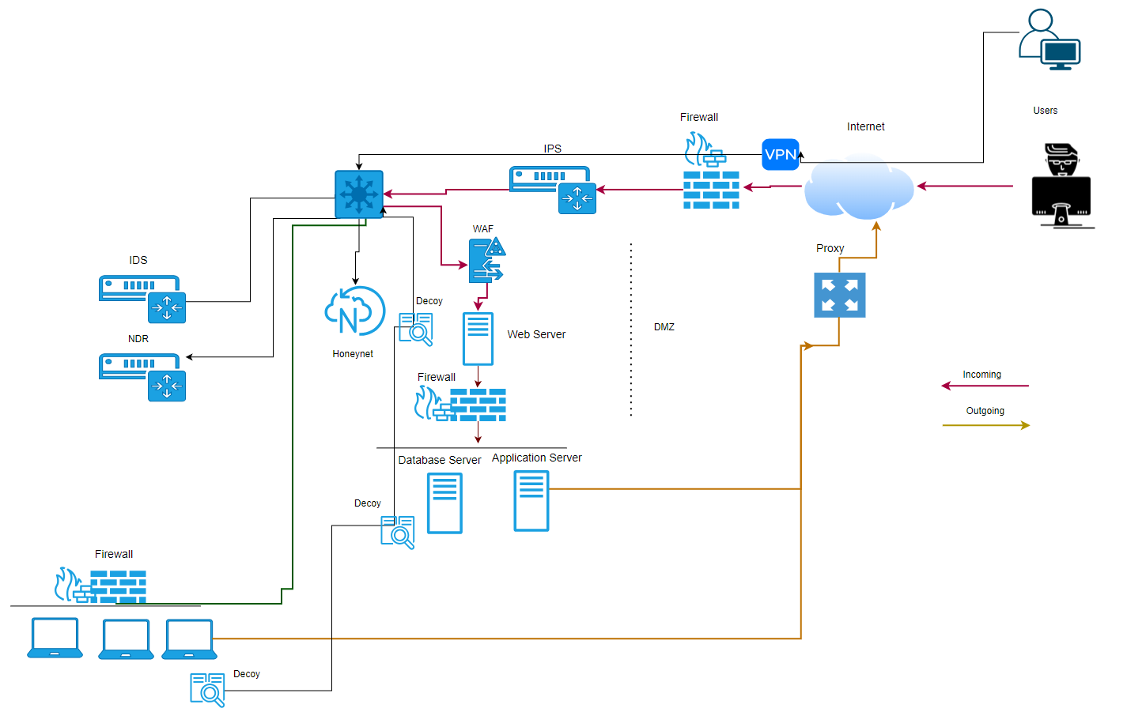
Network Diagram
For training Purposes

Slide 23
Concepts
Security is everyone's responsibility
3
Cryptography
Endpoint Security

Slide 24
Endpoint Security
Protect your front door
HIPS.
DLP.
HIDS.
Host Intrusion Prevention System
Data Leak/Loss Prevention
Host Intrusion Detection System
Antimalware.
Firewall.
EDR.
Host Firewall
Endpoint Detection and Response
Whitelisting.
FDE.
NAC.
Full-disk encryption
Application whitelisting
Network Access Control
FIM.
Logging.
Traffic Stirring .
File Integrity Monitoring
File Integrity Monitoring

Slide 25
Concepts
Security is everyone's responsibility
4
Cryptography
Malwares

Slide 26
Malwares
Security is everyone's responsibility
Ransomware.
Trojan horse.
Rootkit
Fileless .
Worm.
Bots/botnets.
Keyloggers.
Spyware.
Viruses.

Slide 27
Concepts
Security is everyone's responsibility
5
Cryptography
Hardening

Slide 28
Hardening
Security is everyone's responsibility
Vulnerabilities.
Technical controls
Services
Users
Default Password
Security Agents.

Slide 29
Concepts
Security is everyone's responsibility
6
Cryptography
Cyber Kill Chain

Slide 30
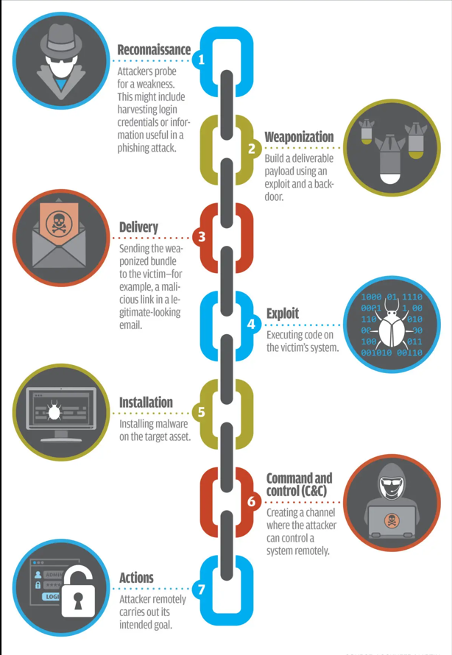
Cyber Kill Chain
Process necessary to achieve desired battlefield effects
What is Cyber Kill Chain ?
In cybersecurity, the cyber kill chain is a model outlining the various phases of common cyberattacks. Using the cyber kill chain, organizations can trace the stages of a cyberattack to better anticipate and prevent against cyber threats in the future
What is lateral movement: ?
Technique that adversaries use, after compromising an endpoint, to extend access to other hosts or applications in an organization.
Lateral movement helps an adversary maintain persistence in the network and move closer to valuable assets.

Slide 31
Concepts
Security is everyone's responsibility
7
Cryptography
Defense in depth

Slide 32
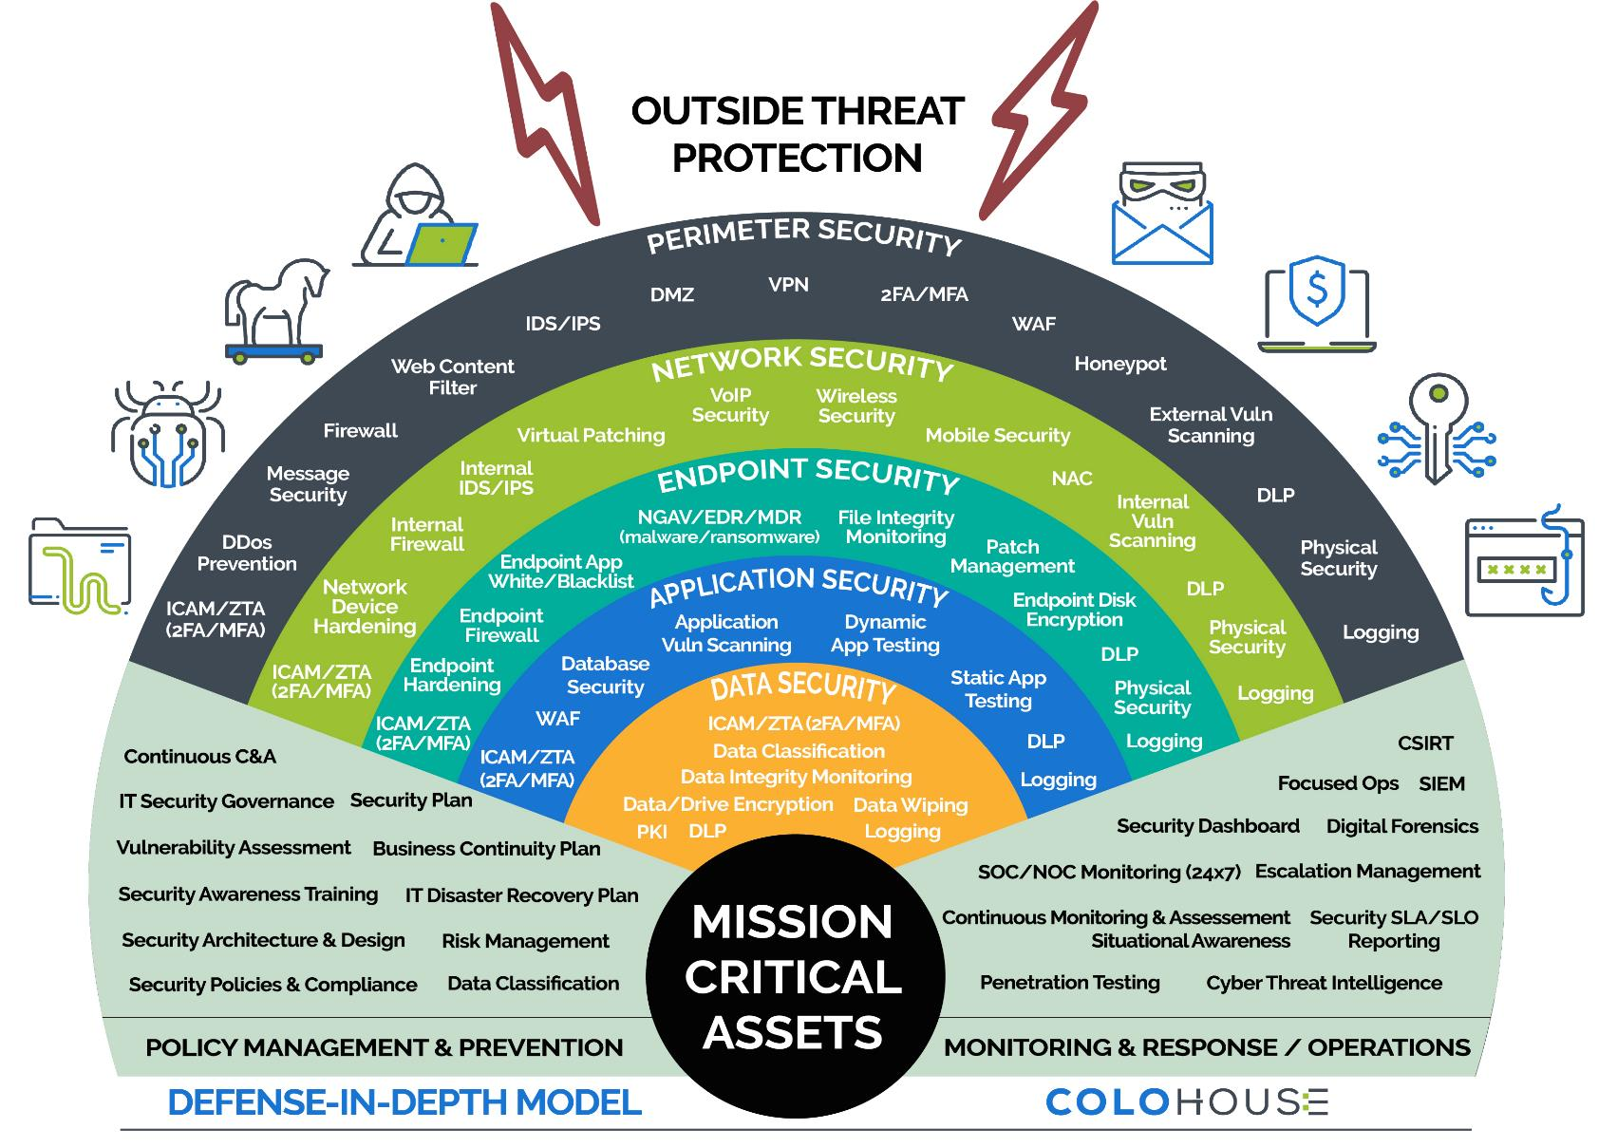
Defense in depth
‘it's better to be safe than sorry’

Slide 33
Concepts
Security is everyone's responsibility
8
CIA Triad

Slide 34
CIA Triad
Security is everyone's responsibility
Confidentiality
It is crucial to be aware of the trade-offs and to reconcile conflicts in achieving confidentiality, integrity, and availability
CIA
Balance
Integrity
Availability

Slide 35
Concepts
Security is everyone's responsibility
9
Data lifecycle

Slide 36
Data lifecycle
Secure the Data
Destroy
Data at Rest
File Encryption, Disk encryption,….
Archive
Create
Data in Motion
TLS, VPN,
Store
Share
Data in Use
Confidential computing (TEE ),Homomorphic encryption
Use

Slide 37
Concepts
Security is everyone's responsibility
10
Threat Modeling

Slide 38
Threat Modeling
Proactive Security
Threat modeling is used at the time of design phase (Proactive ) to prevent future cost and effort in security & future development (patches), however it also used after system deployed (Reactive) to find the threats which weren't addressed, that can be also found by threat hunting
Why
Goal
Predicting threats .
Eradicate (eliminate or reduce) threats

Slide 39
Threat Modeling
ATASM
STRIDE
Architecture, Threats, Attack Surfaces, and Mitigations.
Enumerate the attack sur- faces that the threats are applied to.
Seek to understand the architecture
List all threat agents, their goals, methods, and objectives.
Look at your architecture’s potential
attack surfaces and look at how the
attack methods and objectives already identified would interact with the attack surfaces being assessed.
Review security controls and the
attack surfaces, removing any Attack surfaces that are sufficiently secured by existing controls.
Spoofing, Tampering, Repudiation, Information disclosure, Denial of service Elevation of privilege: is used to map out your application based on it's unique use cases and business logic, “what can go wrong in this system we're working” on?
DREAD (Abandoned)
Damage, Reproducibility, Exploitability, Affected Users, Discoverability: Is a framework that can be used to evaluate and triage various threats by rating them on an ordinal scale.
PASTA
Process for attack simulation and threat analysis: Is risk- centric for business needs Aims to select or develop countermeasures in relation to the value
of the assets to be protected.
VAST
Visual, Agile, and Simple Threat: Is a threat modeling concept that integrates threat and risk management into an Agile programming environment on a scalable basis

Slide 40
Concepts
Security is everyone's responsibility
11
Cryptography
False Positive

Slide 41
Confusion matrix
Reduce false positive and false negative
Email Example
Predicted Control Alert
Normal
Spam
Non-Spam
Spam
True Positive=45%
False Negative=20%
Actual
Non-Spam
False Positive=5%
True Negative=30%
True Positive
False Negative
45% real spam emails are classified correctly
20% real spam emails are classified as non-spam incorrectly
False Positive (F+)
True Negative
5% non-spam emails are classified as spam incorrectly
30% non-spam emails are classified correctly

Slide 42
Concepts
Security is everyone's responsibility
6
AAA

Slide 43
AAA
The three As in this abbreviation refer to authentication, authorization, and accounting .However, what is not as clear is that although there are three letters in the acronym, it actually refers to five elements
Auditing is recording a log of the events and activities related to the system and subjects
Authorization is defining the permissions (i.e., allow/grant and/or deny) of a resource
Identification is claiming to be an identity when attempting to access a secured area or system
Accounting
Authentication is proving that you are that claimed identity
Auditing
Authorization
Authentication
Accounting (aka accountability) is reviewing log files to check for compliance and violations in order to hold subjects accountable for their actions
Identification

Slide 44
Concepts
Security is everyone's responsibility
18
Cryptography
VPN
This type of VPN is also known as a host-to-host VPN or an end-to-end encrypted VPN

Slide 45
Concepts
Security is everyone's responsibility
20
Cryptography
PCI DSS

Slide 46
Account Data
Cardholder Data Includes
Primary Account Number (PAN)
Storage Restriction [Data kept to minimum]
Stored as Readable [No]
Exception : and business must provide justifications
Masked (Unreversible) : Either X mark or some logic.
Hash (Unreversible) : Hashing and salting.
Encryption : Only strong encryption + key management (KEK & KDK)
Not allowed
Encoded (Reversible): Not Allowed.
Cardholder Name
Storage Restriction [Data kept to minimum]
Stored as Readable [Yes]
Expiration Date
Storage Restriction [Data kept to minimum]
Stored as Readable [Yes]
Service Code
Storage Restriction [Data kept to minimum]
Stored as Readable [Yes]
Sensitive Authentication Data Includes
Full Track Data (Magnetic Stripe data or equivalent on chip)
Storage Restriction [No, Cannot be stored after Authorization]
Stored as Readable [No]
Exception : Encrypted until Authorization, immediately to be removed after Authorization
Card Verification code
Storage Restriction [No Cannot be stored after Authorization]
Stored as Readable [No]
Exception : Encrypted until Authorization, immediately to be removed after Authorization
Pins/Pin Blocks
Storage Restriction [No, Cannot be stored after Authorization]
Stored as Readable [No]
Exception : Encrypted until Authorization immediately to be removed after Authorization
Card Number Schema
BIN 6
123456MMMMMM1234
M = Masking 6 digits
BIN 8
12345678MMMM1234
M = Masking 4 digits
Continuous Assurance
Or Any significant change
Daily log review (SIEM)
Quarterly days cycle:
Internal VA
External VA (ASV: External Vendor, Qualys)
User Management Review
Wireless scans
Process is Mandatory tool CDD is Optional
Semi-annual:
Firewall Cleansing
Segmentation PT
Annual:
Internal Application PT
External Application PT
Internal Network PT
External Network PT

Slide 47
Concepts
Security is everyone's responsibility
6
Cryptography

Slide 48
Cryptography
Encryption is a way to conceal information
Encryption
1
Reversible Algorithm
Symmetric
1.1
Shared Key
Hashing
2
Irreversible Algorithm
Asymmetric
1.2
Public Key, Private Key
Digital signature
3
stamp
https://gchq.github.io/CyberChef/

Slide 49
Cryptography
Lets use the web
1
Can you list few of Symmetric algorithms ?
2
Can you list few of Asymmetric algorithms ?
3
Can you list few of Hashing algorithms ?
What does HMAC provide?
4
Digital signature: What Certificate attributes includes ?
5
Encoding ? Do you consider Encoding an Encryption?

Slide 50
Concepts
Security is everyone's responsibility
6
Monolithic Application

Slide 51
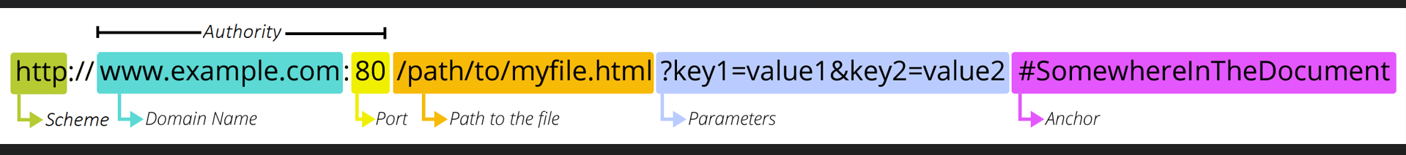
What is HTTP
Security is everyone's responsibility
https://www.tutorialspoint.com/http/index.htm

Slide 52
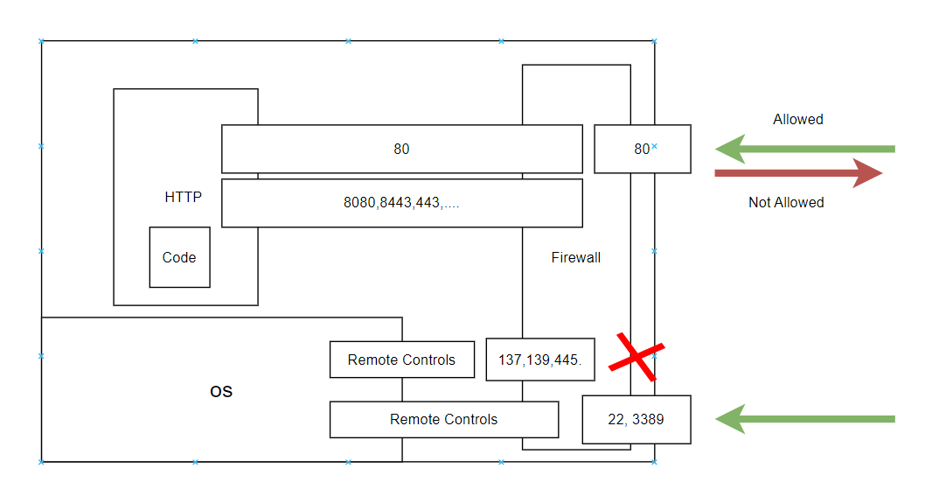
Monolithic Server
Security is everyone's responsibility

Slide 53
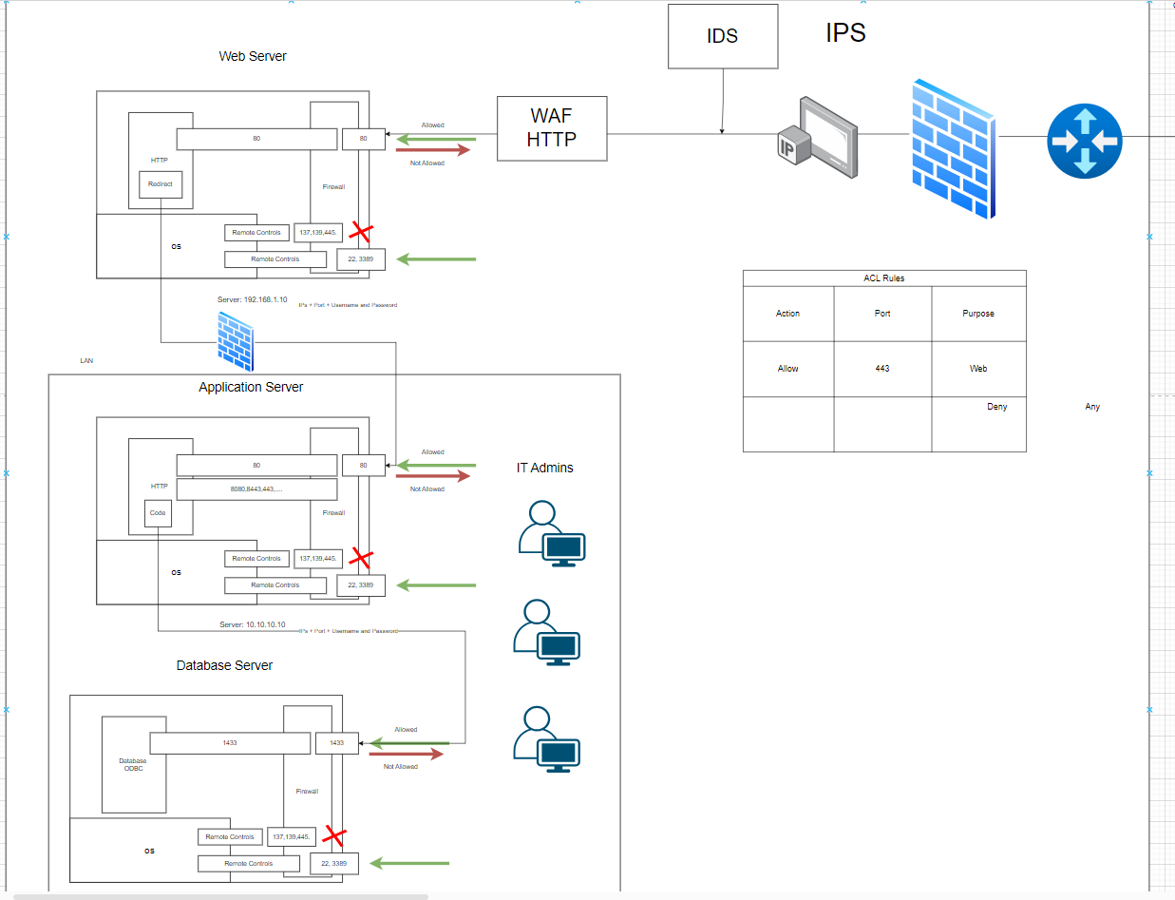
Monolithic App Security
Security is everyone's responsibility

Slide 54
Concepts
Security is everyone's responsibility
6
Microservices Application

Slide 55
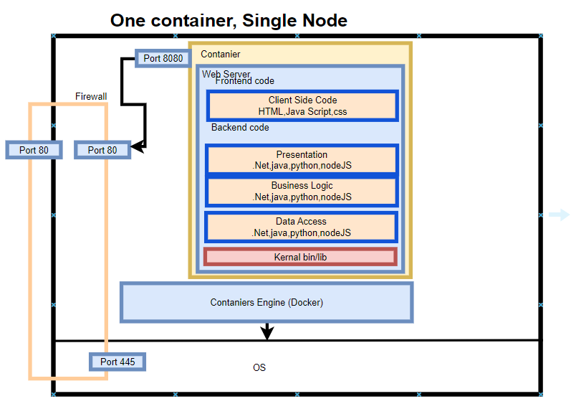
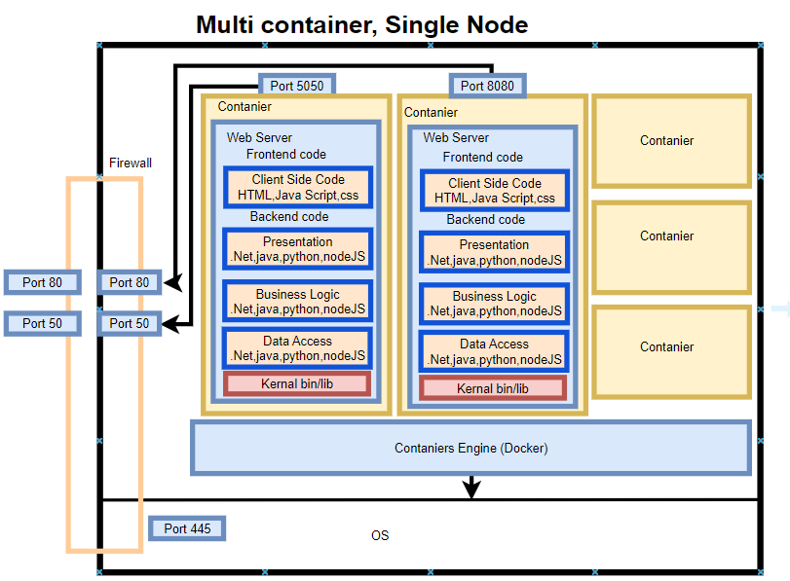
Microservices

Slide 56
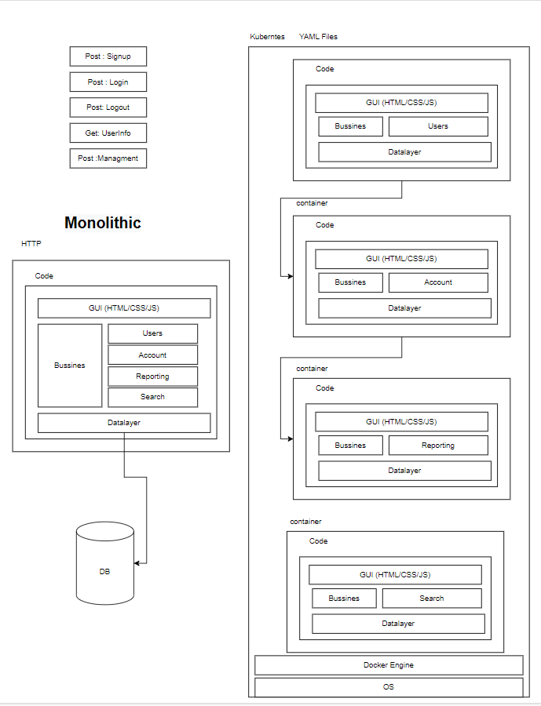
Technical Comparison

Slide 57
Discussing Microservices
“Lift and shift” existing applications into modern cloud architectures
Development
Releases
Deployment
1- More Coherent & Less Coupling
2- Easy Maintenance
3- Fast Development
1- Release as one package
2- Easy Delivery
3- Version Controlled
1- Segregation to handle deployment
2- Less overhead on Developer
3- Cross Platform
4- Easy Troubleshooting
5- Stable Integration
6- Less Configuration
Upgrade
Scalability
1- As New Deployment with having current version running
1- You can Scale Resources depending on demand Automatically
Availability
1- Service Availability (Not OS Availabily and Not DR Availabilty)

Slide 58
Exercise
Build Your first Microservice
Write simple HTTP API using python
Step 1
Upload the code to GitHub portal (Optional)
Step 2
Create Docker container
Step 3
Deploy Docker into Docker Desktop
Step 4
Upload Code to Artifact Docker Hub (Optional)
Step 5

Slide 59
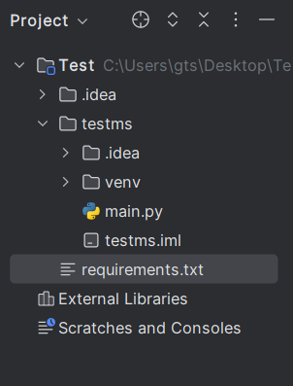
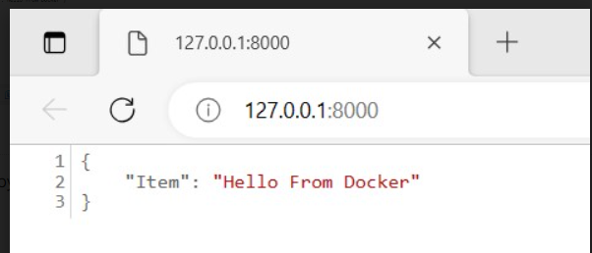
HTTP Get API
Simple Code
Install IntelliJ IDEA Community Edition
Install Python Latest Version
Check pip Installation (System Variables)
pip install fastapi uvicorn
Create requirements.txt File
fastapi>=0.68.0,<0.69.0
pydantic>=1.8.0,<2.0.0
uvicorn>=0.15.0,<0.16.0
Write the below code (main)
from typing import Union
from fastapi import FastAPI
app = FastAPI()
@app.get("/")
async def get():
return {"Item": “Hello From Docker"}
https://fastapi.tiangolo.com/deployment/docker/
uvicorn main:app --port 8080 --reload
https://github.com/BugsCleaners/ApplicationIntroduction

Slide 60
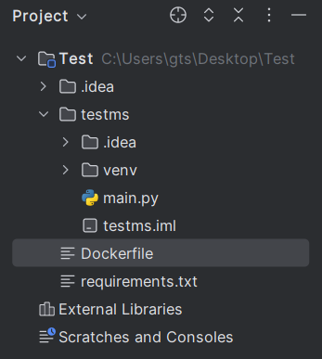
Docker
Simple Code
Install Docker Desktop Engine
Create Dockerfile in the main (Test) Directory
Write the below Commands
FROM python:latest
WORKDIR /code
COPY ./requirements.txt /code/requirements.txt
RUN pip install --no-cache-dir --upgrade -r /code/requirements.txt
RUN pip install fastapi uvicorn
COPY ./ms1 /code/app
CMD ["uvicorn", "app.main:app", "--host", "0.0.0.0", "--port", "80"]
Build The Image
Docker build –t myname .
Docker tag ImageID DockerhubUsername/RepoName:TagName
Login using your Username/Password
Docker push DockerhubUsername/RepoName:TagName

Slide 61
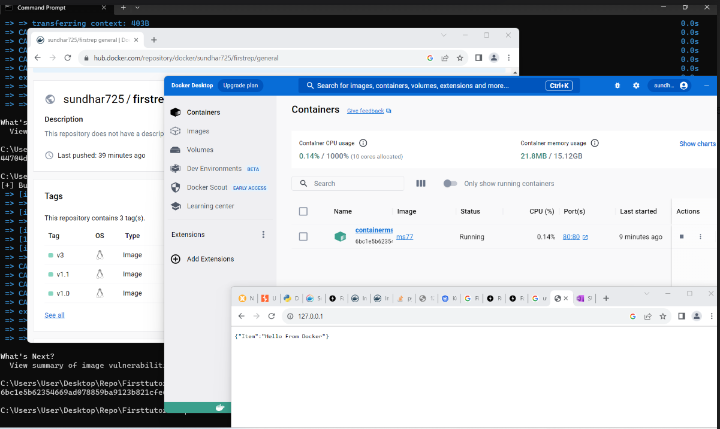
Result

Slide 62
DO YOU HAVE ANY
QUESTIONS?

Slide 63
THANK YOU!
KEEP IN TOUCH

